Slide 1
Density
Year 7 Science

Slide 2
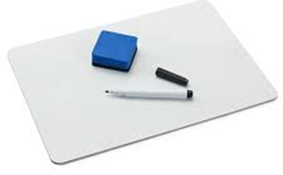
Review
List as many physical properties as you can.
Explain the difference between physical and chemical properties.
Explain why different substances have different melting and boiling points.
Give two examples of chemical properties.
Describe two differences between evaporation and boiling.

Slide 3
Learning Intentions
Mixtures, including solutions, contain a combination of pure substances that can be separated using a range of techniques.

Slide 4
Success criteria
Define density as a physical property.
Explain that density is a factor of mass and volume.
Describe two ways to measure volume
Calculate density for different objects.

Slide 5

Density

Slide 6
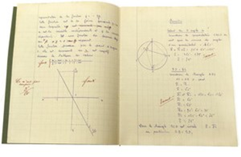
Density 28/04/2024
Density is how much “stuff” an object contains in the space it takes up or how heavy it is for its size.
Density = mass
volume
(in kg)
(in L)
(in kg/L)

Slide 7

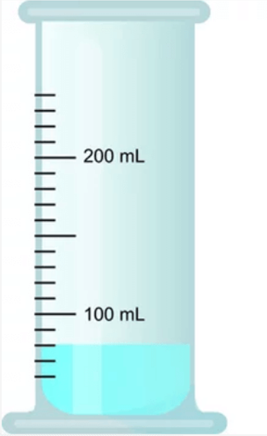

Measuring volume

Slide 8
Activity: Measuring density
Object | Mass | Volume | Density

Slide 9
Success criteria
Define density as a physical property.
Explain that density is a factor of mass and volume.
Describe two ways to measure volume
Calculate density for different objects.

